Slide 1




Bazario Inc.
04.09.2025
BAZARIO
Presented by – EWU students
Trends, Opportunities & Future Outlook

Slide 2
Team Members & Roles
1. Farhana Ahmed Tasnim
2. Md Sifat Ullah Sheikh
3. Apurbo Chandra Paul
4. Ragib Mahatab
ID: 2022-1-60-156
Roles:
ID: 2022-1-60-029
ID: 2020-3-60-092
Roles:
ID: 2021-1-60-050
Roles:
Roles:
Software Development
Software Testing
Requirements Engineering
Software Design
Software Testing
Software Design
Software Maintenance
Requirements Engineering

Slide 3

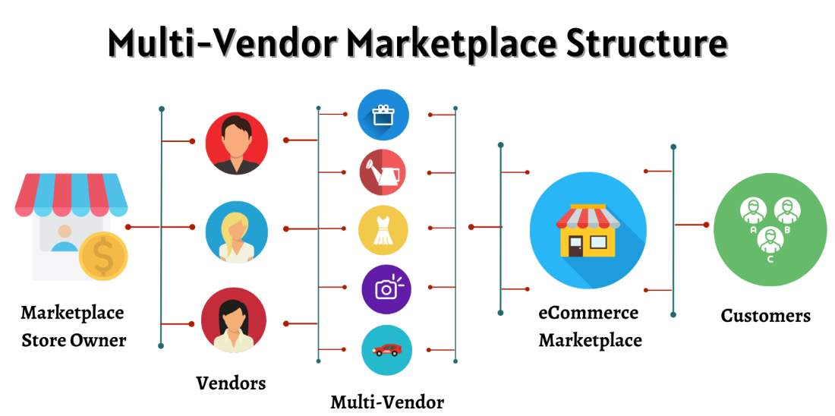
Project Overview
Project Description
Marketplace for multiple online sellers
Seller product management system
Easy customer-seller interaction
Centralized orders from various vendors

Slide 4

1
2
4
3
All-In-One Shopping Platform
Declining ethnobotanical knowledge
Need for intelligent digital systems
Challenges in manual identification
Motivation

Slide 5




1
2
3
4
All-In-One Shopping Platform
Marketplace
Platform
Easier Infrastructure
Need for intelligent digital systems
Improved User
Experience

Slide 6
03
04
02
01
Applications
Education
Sustainability
Health Care
Community

Slide 7

01
02
03
04
Scope
Build a full-stack, multi-tenant
e-commerce marketplace
Implement secure user and vendor features
Enable powerful content and product management
Design a
responsive and modern UI

Slide 8



Build a full-stack, multi-tenant e-commerce marketplace
using the MERN stack with vendor-specific subdomains and customizable storefronts

Slide 9
Implement secure user and vendor features
including account management, Stripe Connect payments, product reviews, order tracking, and role-based dashboards

Slide 10
Enable powerful content and product management
Payload CMS, with support for categorization, filtering, search, and image uploads

Slide 11
Design a responsive and modern UI
using TailwindCSS and ShadcnUI components for consistent, user-friendly styling

Slide 12






Experience Enhancers
Related Product
Search
Machine Learning Model
Features will be displayed on homepage

Slide 13
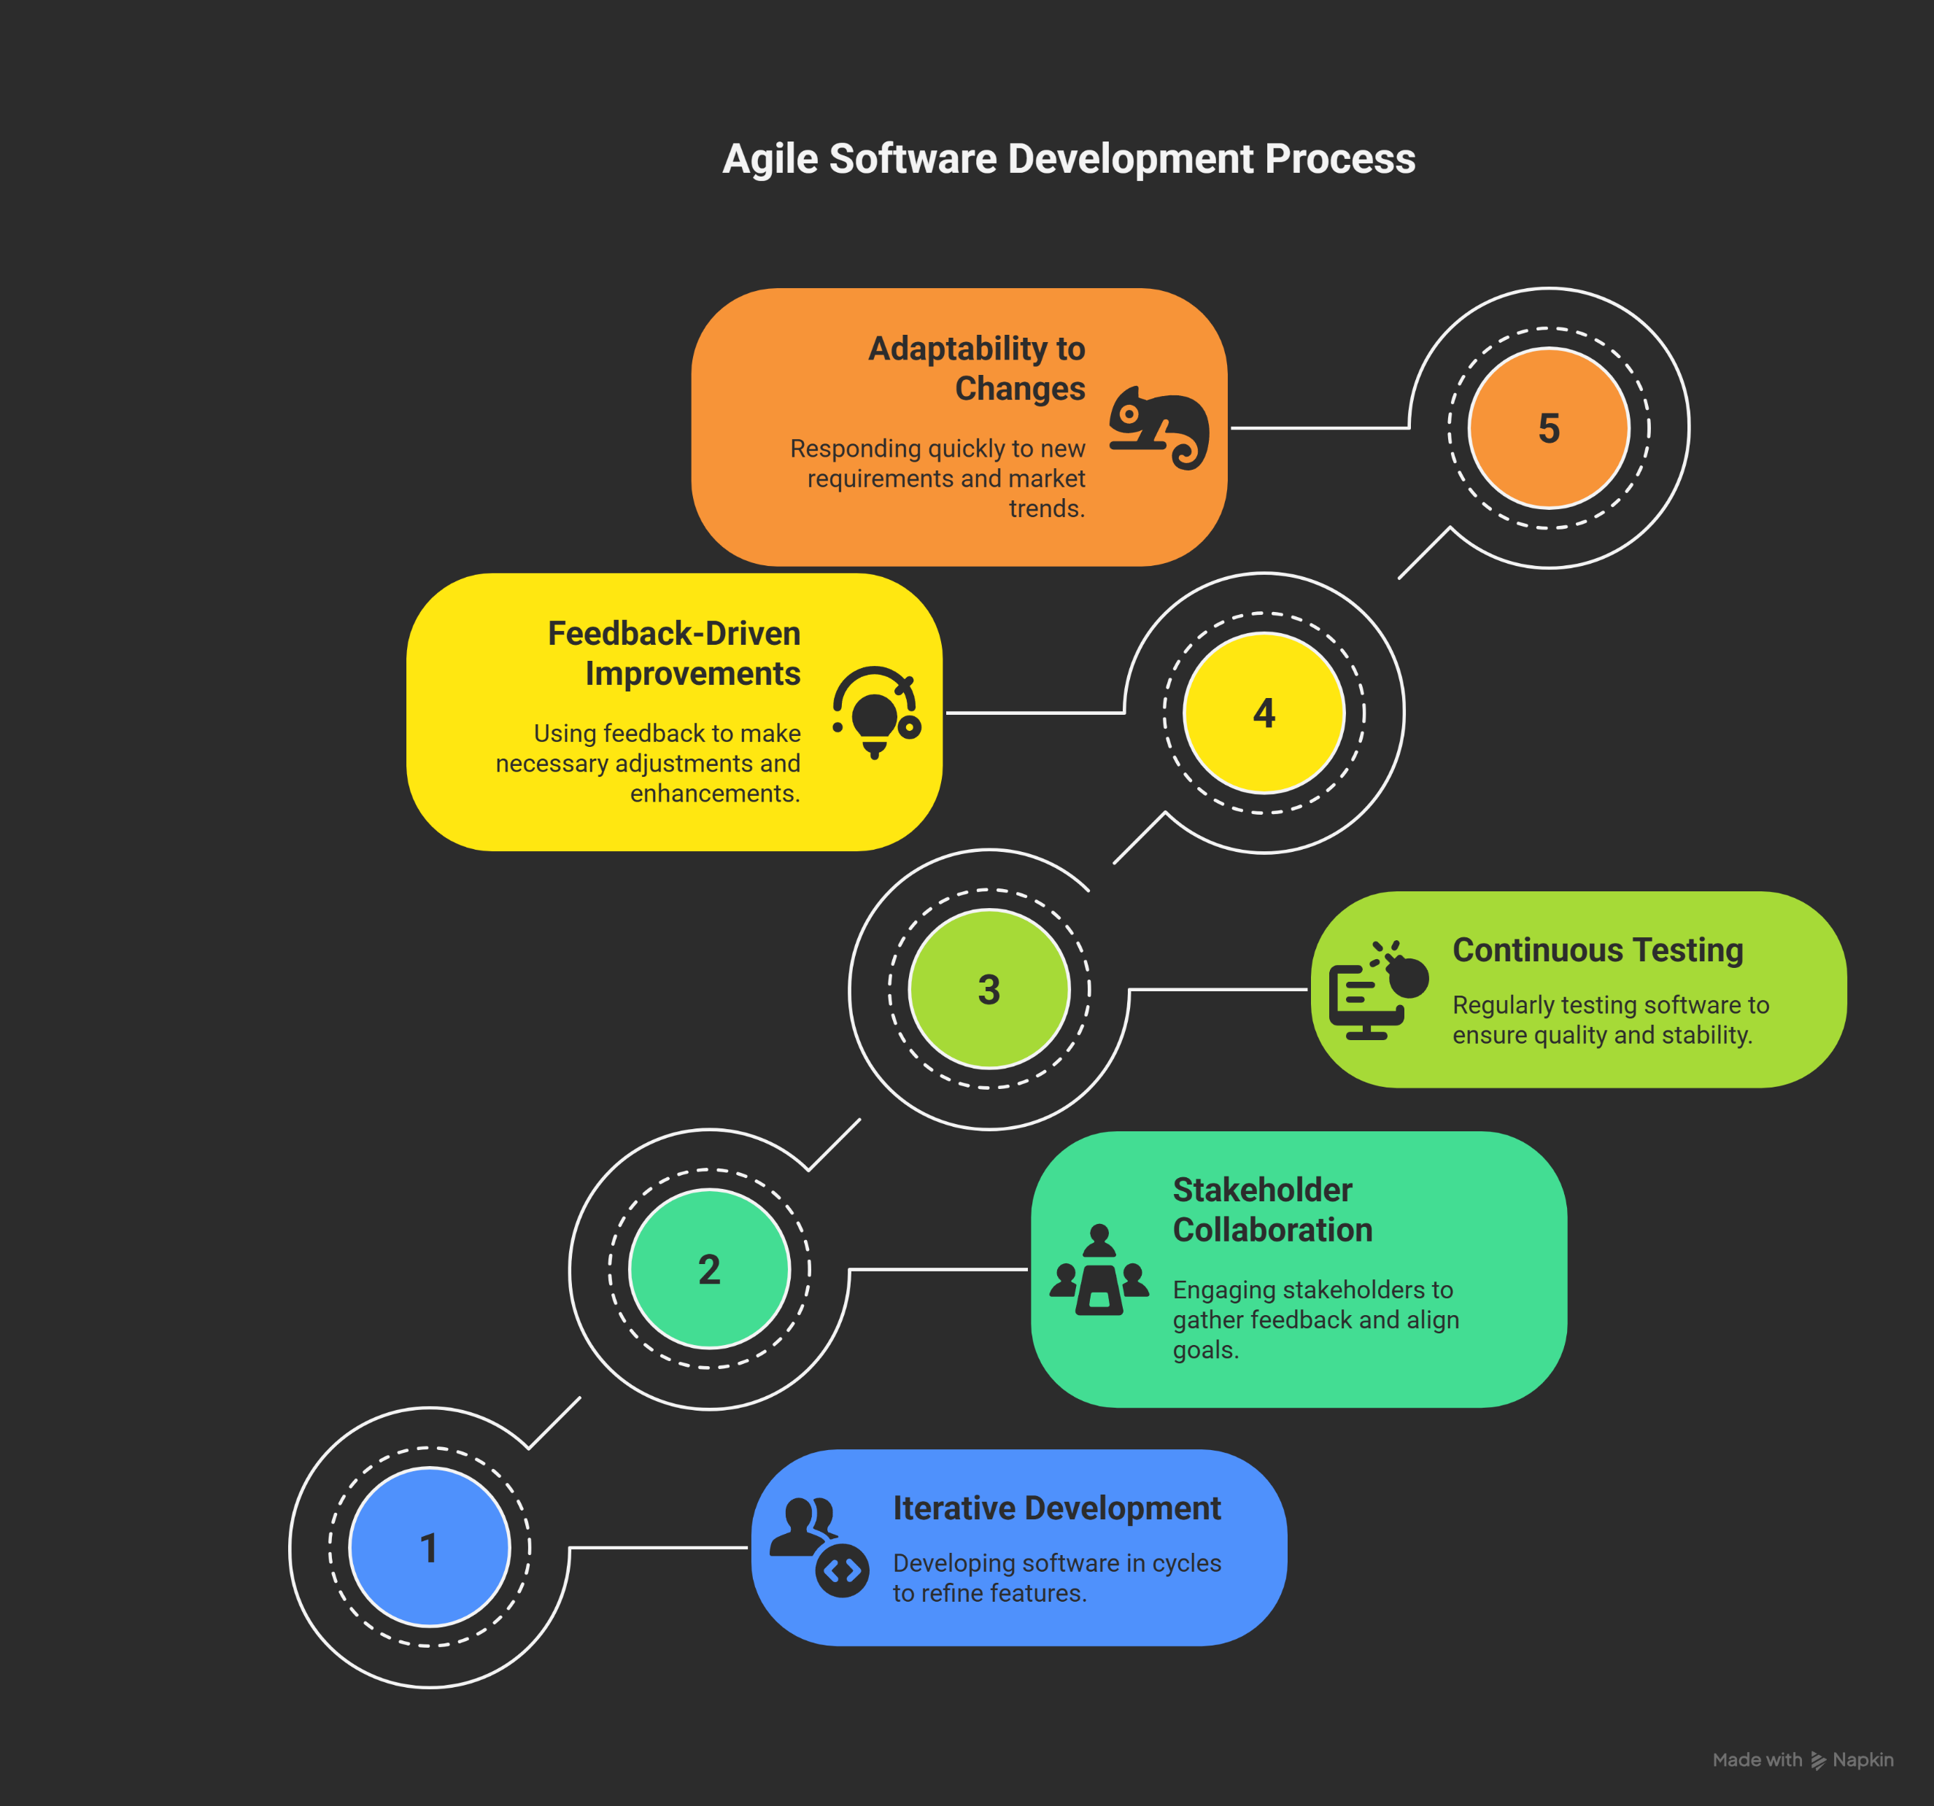
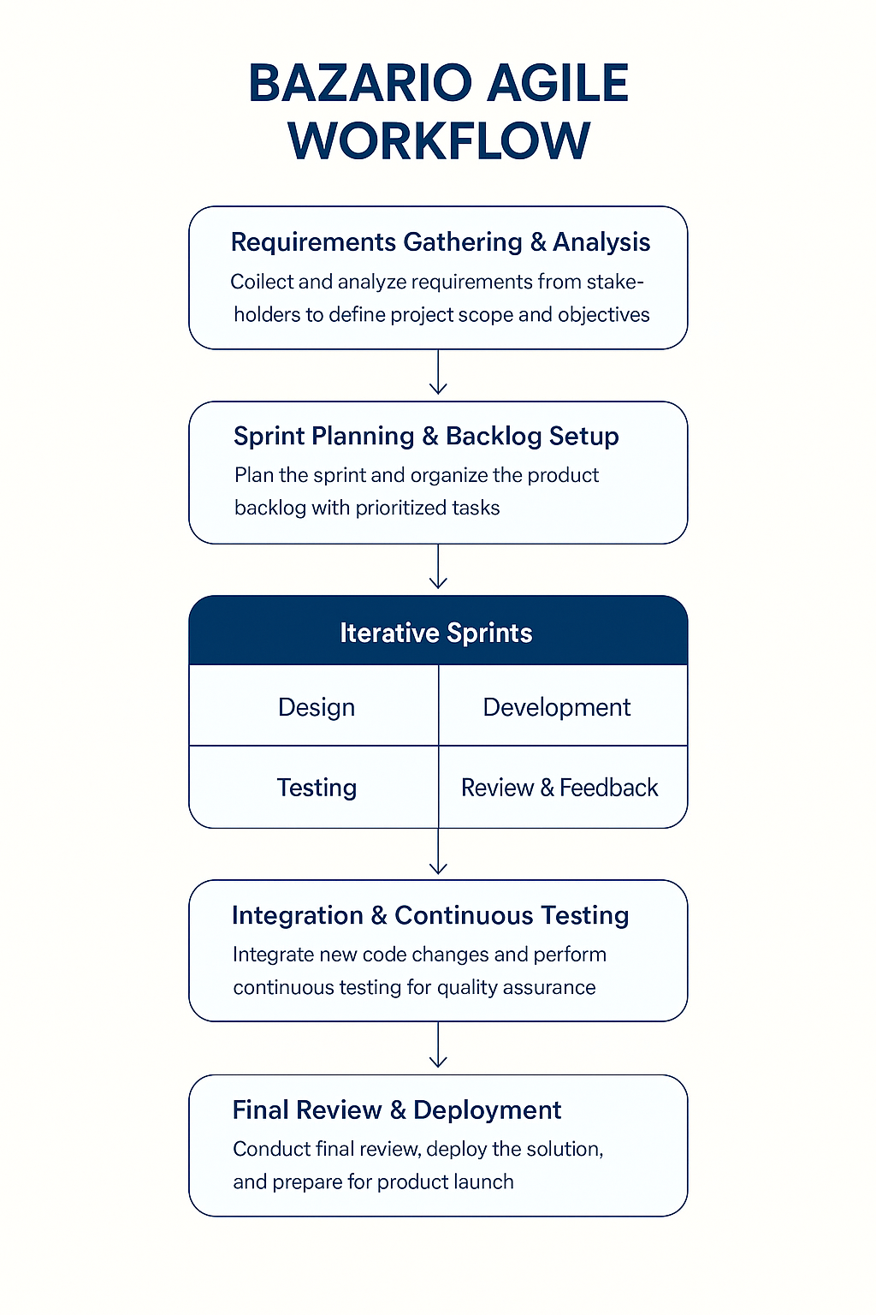


Slide 14
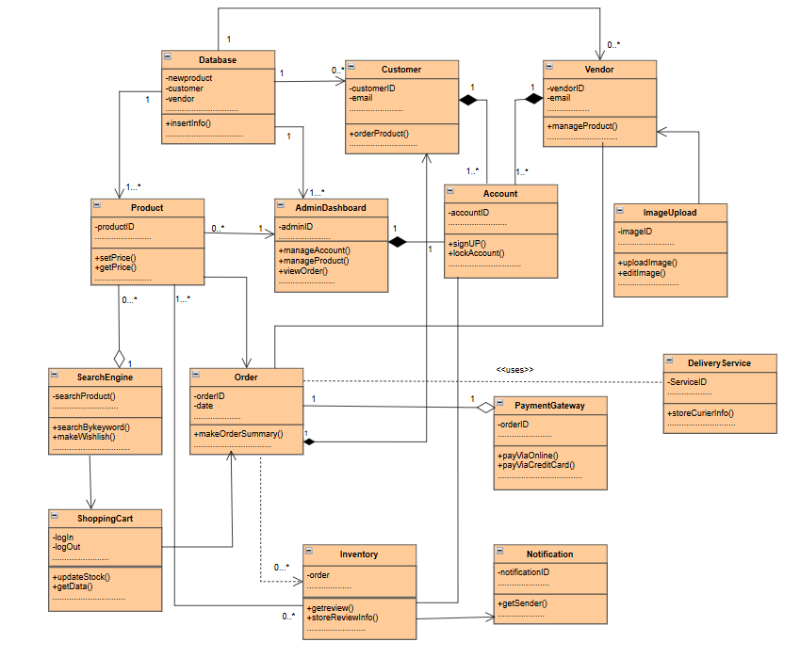
Class Diagram

Slide 15
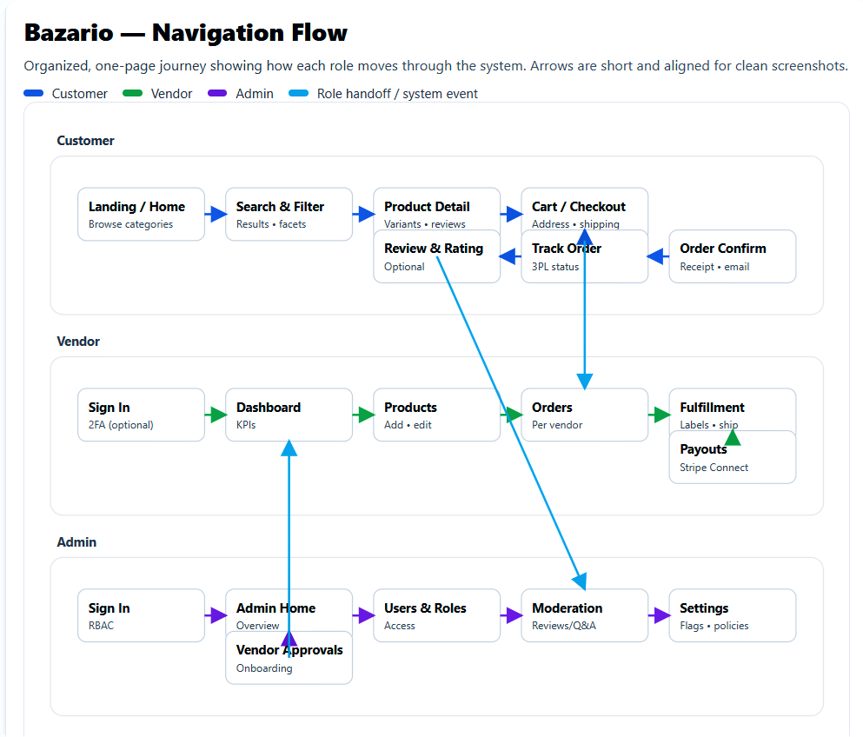
Navigation Flow

Slide 16

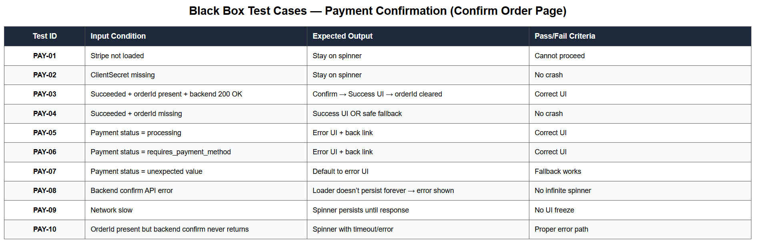


Software Testing
Fradel and Spies
Stay Tuned for More Exciting Trends and Tips in Online Shopping!

Slide 17

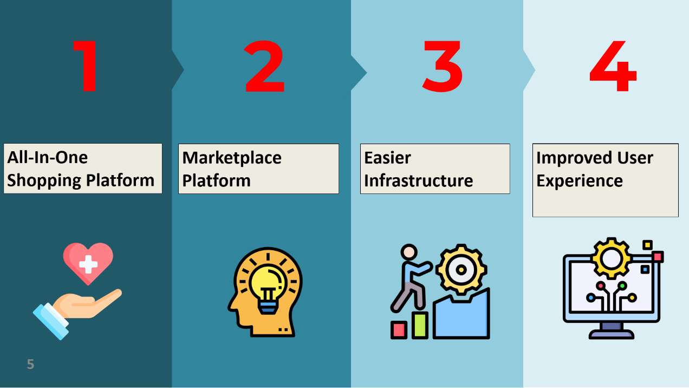
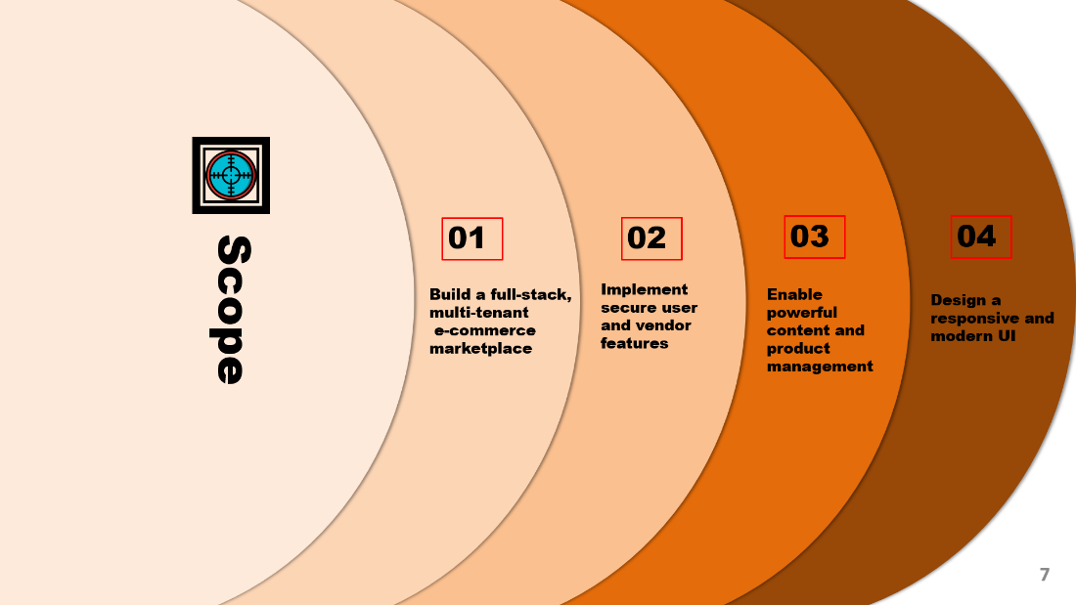
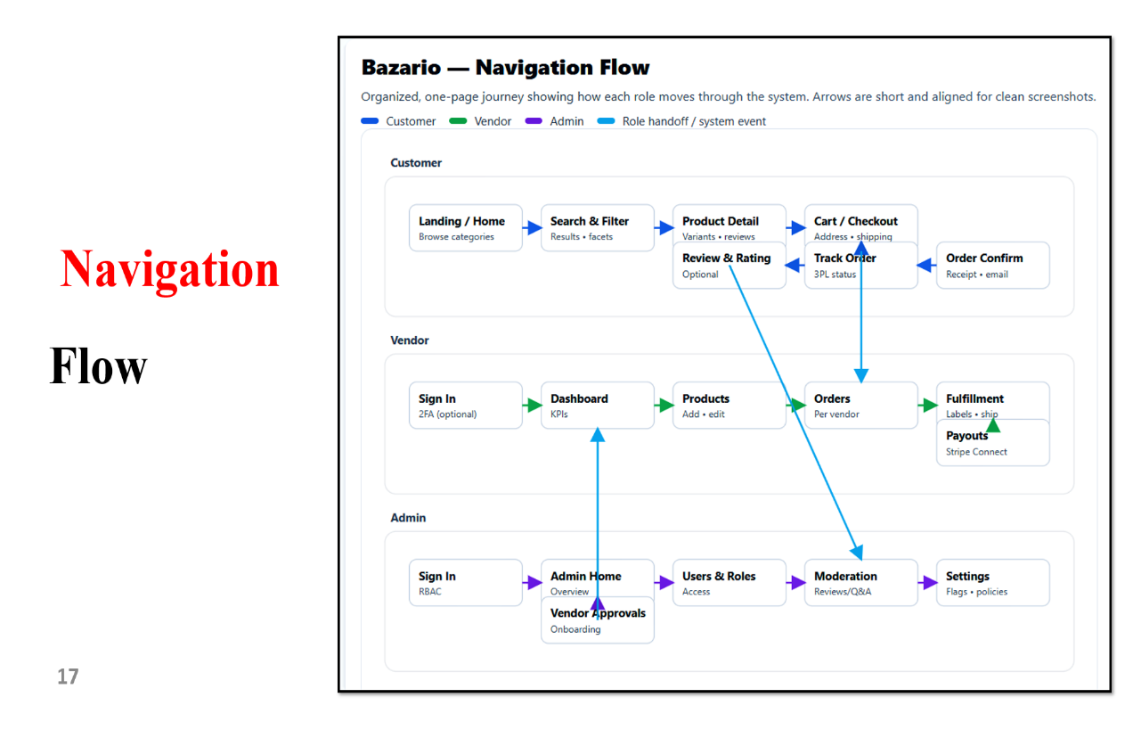
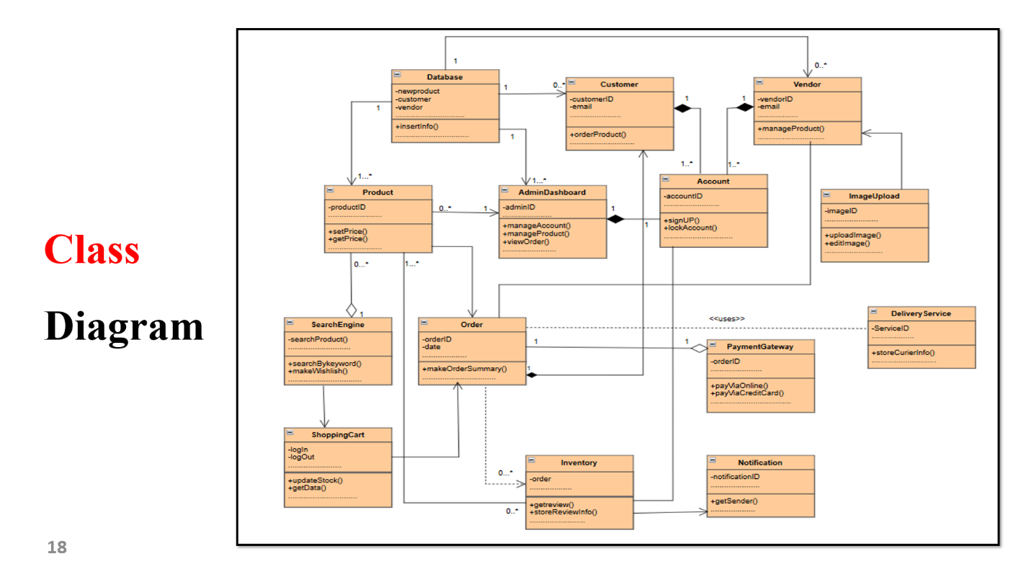
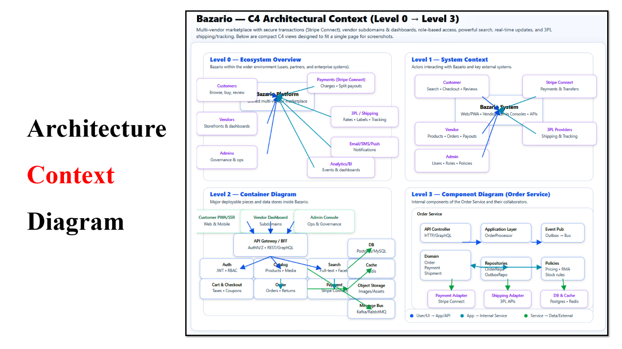

Summary

Slide 18





Bazario Inc.
get in touch
with us
Multi vendor E-commerce
Bazario.official
bazario.com@gmail.com

